Slide 1
Spark

Slide 2
Spark
Apache Spark is a cluster computing framework for large-scale data processing.
Unlike most of the other processing frameworks, Spark does not use MapReduce as an execution engine; instead, it uses its own distributed runtime for executing work on a cluster.
However, Spark has many parallels with MapReduce, in terms of both API and runtime
Spark is closely integrated with Hadoop: it can run on YARN and works with Hadoop file formats and storage backends like HDFS.
Spark is best known for its ability to keep large working datasets in memory between jobs. This capability allows Spark to outperform the equivalent MapReduce workflow, where datasets are always loaded from disk

Slide 3
Spark
A new general framework, which solves many of the short comings of MapReduce
It is capable of leveraging the Hadoop ecosystem, e.g. HDFS, YARN, HBase, S3, …
Has many other workflows, i.e. join, filter, flatMapdistinct, groupByKey, reduceByKey, sortByKey, collect, count, first…
(around 30 efficient distributed operations)

Slide 4
Spark
In-memory caching of data (for iterative, graph, and machine learning algorithms, etc.)
Native Scala, Java, Python, and R support
Supports interactive shells for exploratory data analysis
Spark API is extremely simple to use
Developed at AMPLab UC Berkeley, now by Databricks.com

Slide 5
Advantages
Two styles of application that benefit greatly from Spark’s processing model are iterative algorithms and interactive analysis
Unlike MapReduce, Spark’s DAG engine can process arbitrary pipelines of operators and translate them into a single job for the user.
Spark’s user experience is also second to none, with a rich set of APIs for performing many common data processing tasks, such as joins.
At the time of writing, Spark provides APIs in three languages: Scala, Java, and Python.
Spark also comes with a REPL (read — eval — print loop) for both Scala and Python, which makes it quick and easy to explore datasets.
Spark is proving to be a good platform on which to build analytics tools, too, and to this end the Apache Spark project includes modules for machine learning (MLlib), graph processing (GraphX), stream processing (Spark Streaming), and SQL (Spark SQL) – Key Features
Notes:
REPL is an acronym for Read-Evaluate-Print Loop. It is an interactive shell used by programmers to interact with a framework.
Key Features :
Batch/streaming data
SQL analytics
Data science
Machine learning

Slide 6
Apache Spark
Apache Spark supports data analysis, machine learning, graphs, streaming data, etc. It can read/write from a range of data types and allows development in multiple languages.
Scala, Java, Python, R, SQL
DataFrames
ML Pipelines
Spark SQL
Spark Streaming
MLlib
GraphX
Spark Core
Data Sources
Hadoop HDFS, HBase, Hive, Apache S3, Streaming, JSON, MySQL, and HPC-style (GlusterFS, Lustre)

Slide 7
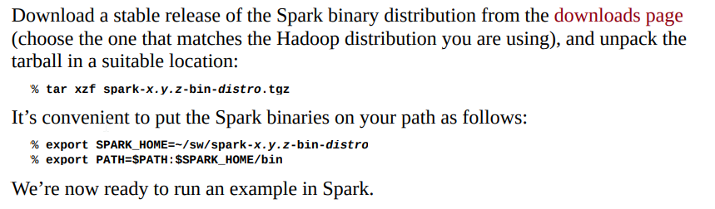
Spark- Installation

Slide 8
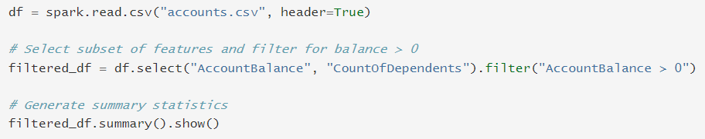

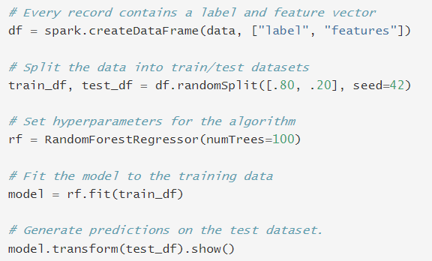

Spark- Python

Slide 9
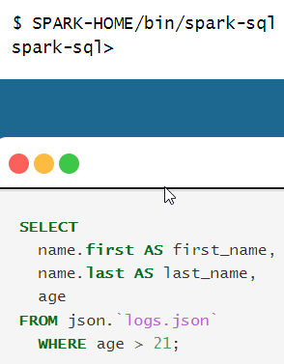
Spark- SQL

Slide 10
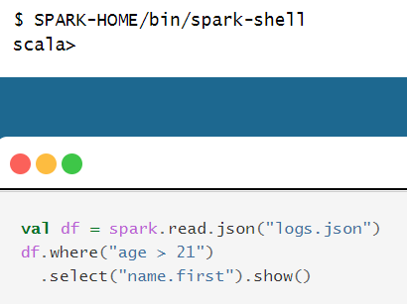
Spark- Scala

Slide 11
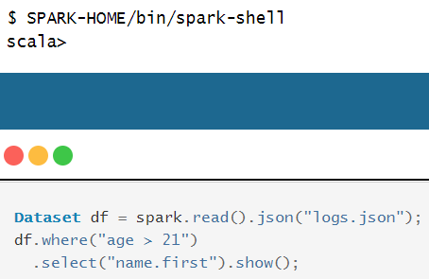
Spark- Java

Slide 12
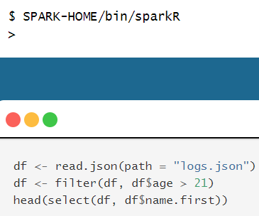
Spark- R

Slide 13
In a typical Spark program, one or more RDDs are loaded as input and through a series of transformations are turned into a set of target RDDs, which have an action performed on them (such as computing a result or writing them to persistent storage).
The term “resilient” in “Resilient Distributed Dataset” refers to the fact that Spark can automatically reconstruct a lost partition by recomputing it from the RDDs that it was computed from.
Loading an RDD or performing a transformation on one does not trigger any data processing; it merely creates a plan for performing a computation. The computation is only triggered when an action (like foreach()) is performed on an RDD.

Slide 14
Spark Applications, Jobs, Stages, and Tasks
As we’ve seen in the example, like MapReduce, Spark has the concept of a job.
A Spark job is more general than a MapReduce job, though, since it is made up of an arbitrary directed acyclic graph (DAG) of stages, each of which is roughly equivalent to a map or reduce phase in MapReduce.
Stages are split into tasks by the Spark runtime and are run in parallel on partitions of an RDD spread across the cluster — just like tasks in MapReduce.
A job always runs in the context of an application (represented by a SparkContext instance) that serves to group RDDs and shared variables.
An application can run more than one job, in series or in parallel, and provides the mechanism for a job to access an RDD that was cached by a previous job in the same application.
An interactive Spark session, such as a spark-shell session, is just an instance of an application.

Slide 15
Reference for Examples and latest documents
https://spark.apache.org/examples.html
https://spark.apache.org/

Slide 16
Resilient Distributed Datasets (RDDs)
RDDs (Resilient Distributed Datasets) is Data Containers
All the different processing components in Spark share the same abstraction called RDD; allows you to write programs that transform these distributed datasets.
RDDs are immutable distributed collection of elements of your data that can be stored in memory or disk across a cluster of machines.
The data is partitioned across machines in your cluster that can be operated in parallel with a low-level API that offers transformations and actions.
As applications share the RDD abstraction, you can mix different kind of transformations to create new RDDs
Created by parallelizing a collection or reading a file
Fault tolerant- as they track data lineage information to rebuild lost data automatically on failure.

Slide 17
DataFrames & SparkSQL
DataFrames (DFs) is one of the other distributed datasets organized in named columns
Similar to a relational database, Python Pandas Dataframe or R’s DataTables
Immutable once constructed
Track lineage
Enable distributed computations

Slide 18
DataFrames
How to construct Dataframes
Read from file(s)
Transforming an existing DFs(Spark or Pandas)
Parallelizing a python collection list
Apply transformations and actions

Slide 19
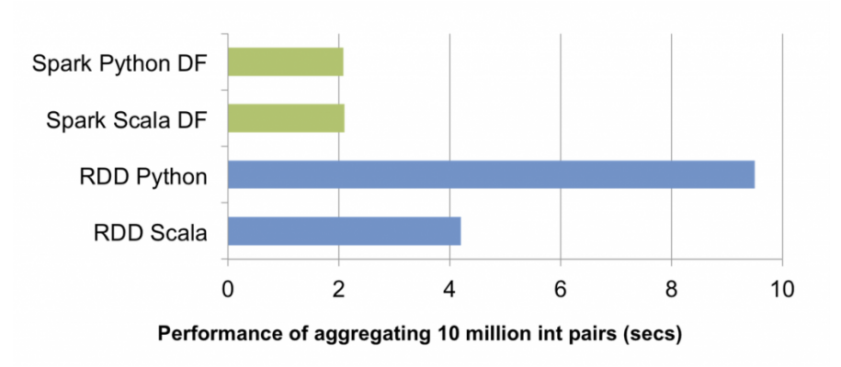
RDDs vs. DataFrames
RDDs provide a low-level interface into Spark
DataFrames have a schema
DataFrames are cached and optimized by Spark
DataFrames are built on top of the RDDs and the core Spark API
Example: Performance

Slide 20
Spark’s Main Use Cases
Streaming Data
Machine Learning
Interactive Analysis
Data Warehousing
Batch Processing
Exploratory Data Analysis
Graph Data Analysis
Spatial (GIS) Data Analysis
And many more

Slide 21
My Spark Use Cases
Fingerprint Matching
Developed a Spark based fingerprint minutia detection and fingerprint matching code
Twitter Sentiment Analysis
Developed a Spark based Sentiment Analysis code for a Twitter dataset

Slide 22
Spark in the Real World
Uber – the online taxi company gathers terabytes of event data from its mobile users every day.
By using Kafka, Spark Streaming, and HDFS, to build a continuous ETL pipeline
Convert raw unstructured event data into structured data as it is collected
Uses it further for more complex analytics and optimization of operations

Slide 23
Spark in the Real World
Pinterest – Uses a Spark ETL pipeline
Leverages Spark Streaming to gain immediate insight into how users all over the world are engaging with Pins—in real time.
Can make more relevant recommendations as people navigate the site
Recommends related Pins
Determine which products to buy, or destinations to visit
Notes:
Pinterest is a social curation website for sharing and categorizing images found online. The site is described in its own content as a visual bookmarking site. Pinterest is a portmanteau of the words “pin” and “interest.”

Slide 24
Spark in the Real World
Here are Few other Real World Use Cases:
Conviva – 4 million video feeds per month
This streaming video company is second only to YouTube.
Uses Spark to reduce customer churn by optimizing video streams and managing live video traffic
Maintains a consistently smooth, high quality viewing experience.

Slide 25
Spark in the Real World
Capital One – is using Spark and data science algorithms to understand customers in a better way.
Developing next generation of financial products and services
Find attributes and patterns of increased probability for fraud
Netflix – leveraging Spark for insights of user viewing habits and then recommends movies to them.
User data is also used for content creation

Slide 26
Spark: when not to use
Even though Spark is versatile, that doesn’t mean Spark’s in-memory capabilities are the best fit for all use cases:
For many simple use cases Apache MapReduce and Hive might be a more appropriate choice
Spark was not designed as a multi-user environment
Spark users are required to know that memory they have is sufficient for a dataset
Adding more users adds complications, since the users will have to coordinate memory usage to run code

